Slide 1
Efficient 16-Band Non-Uniform Filter Bank For Hearing Aids
BATCH NUMBER: B8
Under the guidance of : Presented by:
Dr. K. Ayyappa Swamy 1. SK. SUHEILA (20A91A04B2)
Associate Professor 2. P. KRISHNA TEJASWI (20A91A04A6)
Department of Electronics and Communication Engineering 3. M. RAMYA DEEPTHI(20A91A0490)
Aditya Engineering College (A) 4. N. VENKATESH YADAV(20A91A0498)
Aditya Engineering College (A)

Slide 2

CONTENTS
Base Paper
Abstract
Introduction
Problem Identification
Literature Review
Demonstration of Final Design Model/Simulation
SWOT Analysis
Screen Shot of Drafted/Communicated/Accepted status of Journal/Conference Paper with Guide Sign
References
Aditya Engineering College (A)

Slide 3
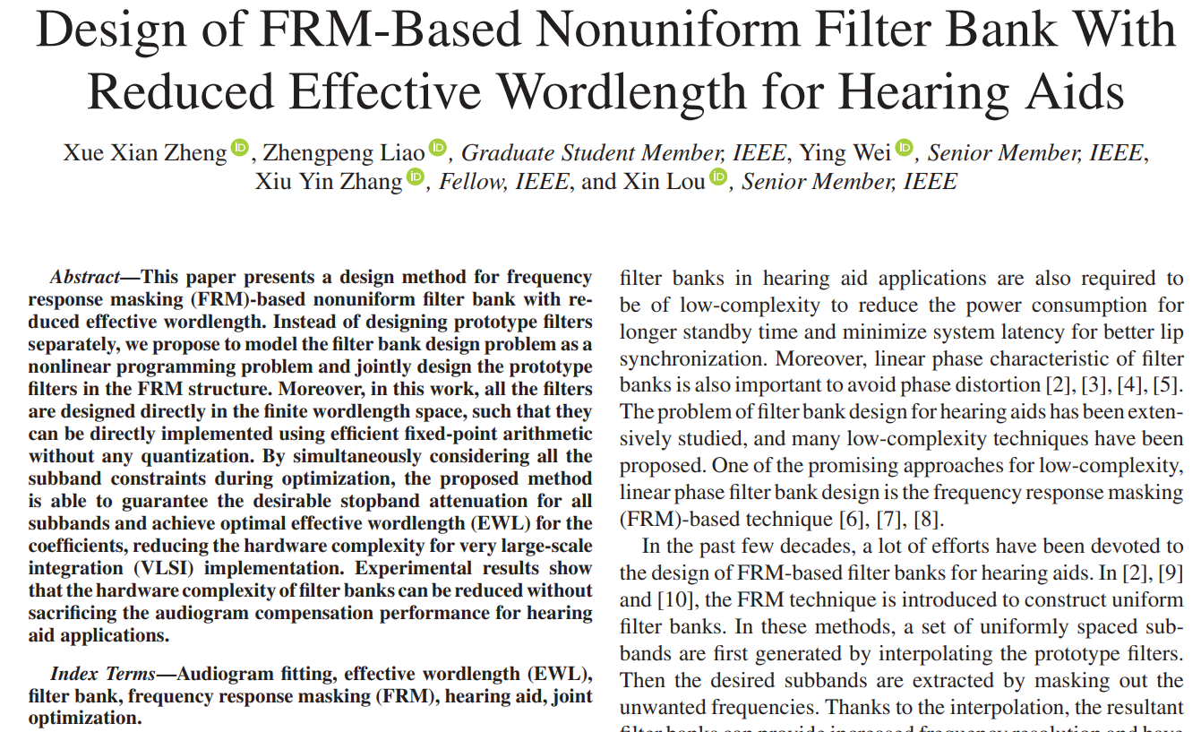
BASE PAPER
Aditya Engineering College (A)

Slide 4
ABSTRACT
This paper proposes an efficient 16-band nonuniform filter bank tailored for hearing aids.
Traditional hearing aid systems often employ uniform filter banks, which may not fully capture the complex spectral characteristics of human hearing.
The proposed filter bank optimizes frequency resolution across critical bands to better match the nonuniform frequency response of the human auditory system.
The design incorporates psychoacoustic principles and signal processing techniques to achieve optimal frequency decomposition while minimizing computational complexity.
Aditya Engineering College (A)

Slide 5
INTRODUCTION
Hearing is one of the most crucial senses for human beings as it connects them to the external world.
The human auditory system can generally hear sounds within the frequency range of 20 Hz and 20 kHz but the frequency range between 100Hz and 6 kHz contains most of the information of the human voice.
Hearing Aid Systems are of Analog and Digital.
Digital hearing aids have all the features of analog programmable aids. So, the usage of digital hearing aids is high at present.
Aditya Engineering College (A)

Slide 6
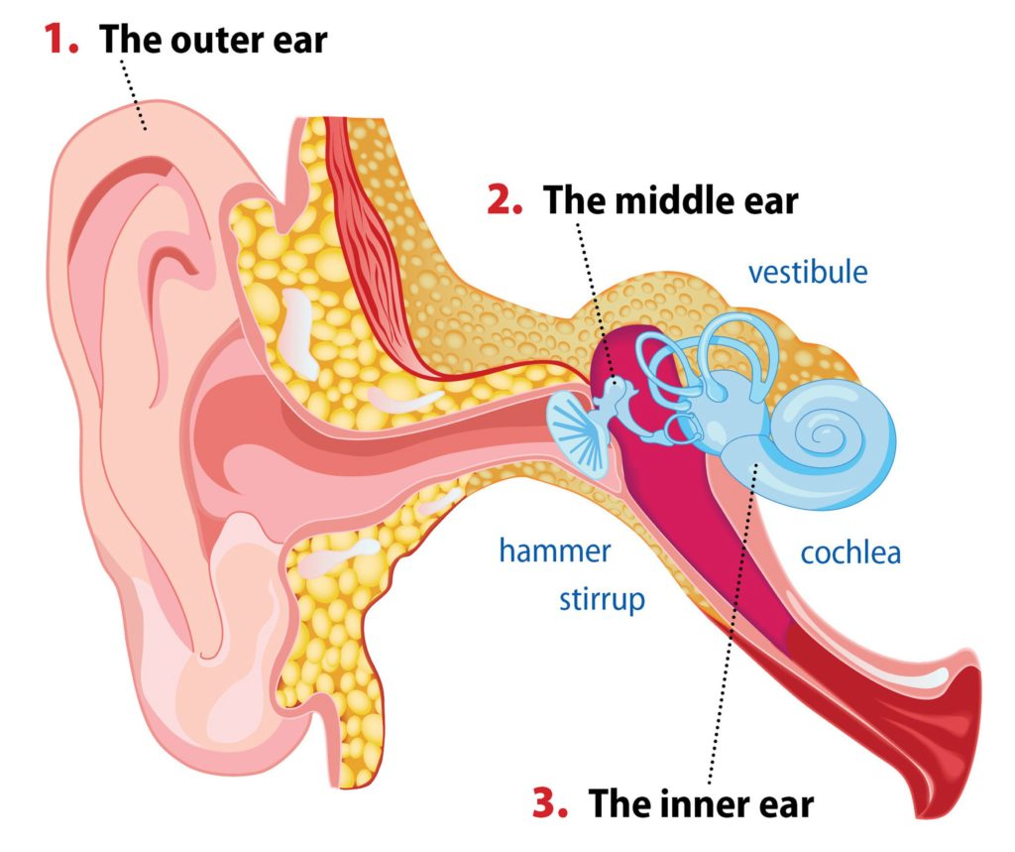
INTRODUCTION
The hearing losses are of 3 main types
1.Sensorineural Hearing loss
2.Conductive Hearing loss
3.Mixed Hearing loss

Slide 7
Problem Identification
Due to the large interpolation factor used to produce narrower bands in 8-band non uniform filter the latency of the filter bank in is exceedingly large.
A modified 16-band based nonuniform filter bank with a small interpolation factor is proposed which halfs the latency.
Concerning the flexibility for different patients, reconfigurable filter banks are designed based on hearing loss frequency.The sub bands of these filter banks can be adjusted in terms of locations and bandwidths.
Aditya Engineering College (A)

Slide 8
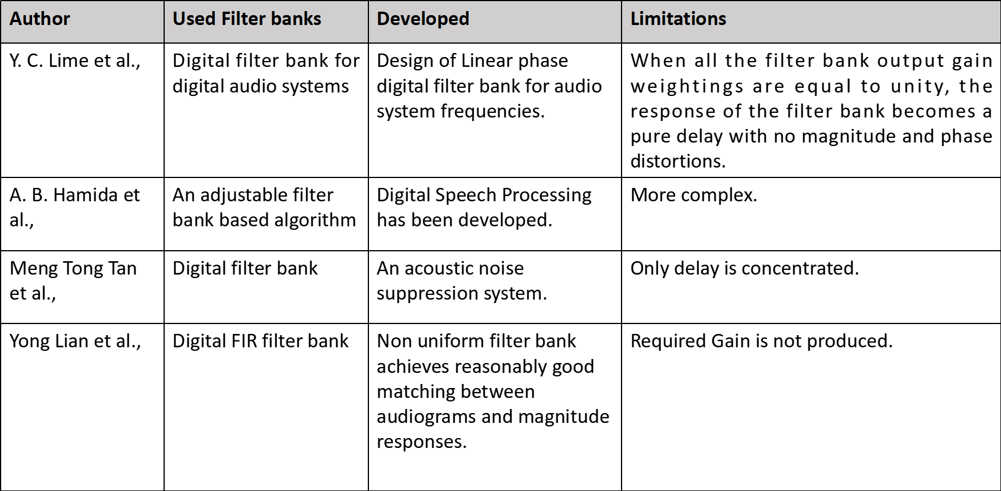
Literature review
Aditya Engineering College (A)

Slide 9
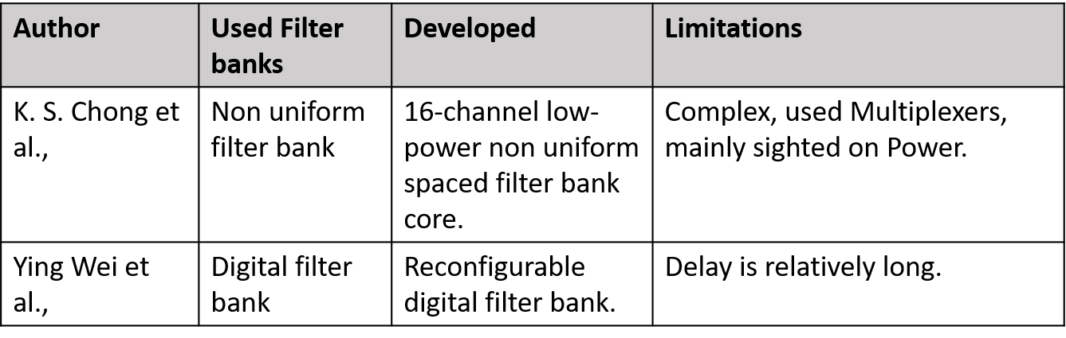
Literature review
Aditya Engineering College (A)

Slide 10

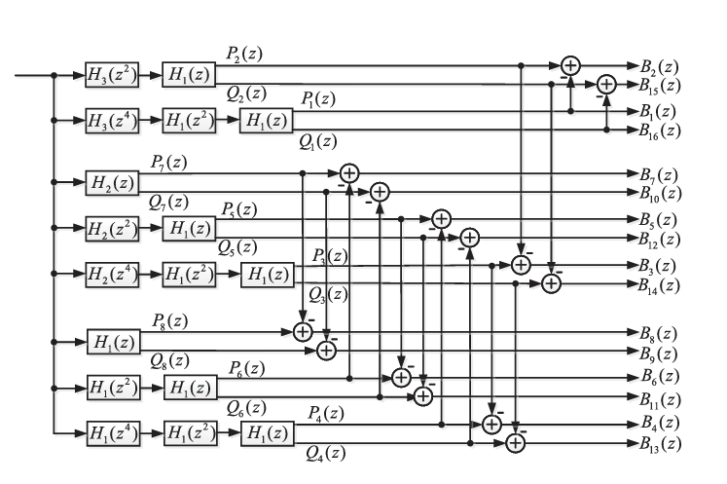
Demonstration of Final Design Model/Simulation
In this method, we design filters H1(z), H2(z), and H3(z) with orders 18, 18, and 36, respectively, aiming for a stopband attenuation of 60 dB. Tuning transition bandwidths to 0.40π, 0.40π, and 0.20π for H1(z), H2(z), and H3(z), respectively, ensures precise frequency response while minimizing computational load. This approach tailors each filter's characteristics for optimal performance within the filter bank. The chosen transition bandwidths strike a balance between filter complexity and achieving the required stopband attenuation, vital for accurate signal processing and noise suppression in the application domain.
Fig: Final design Model

Slide 11
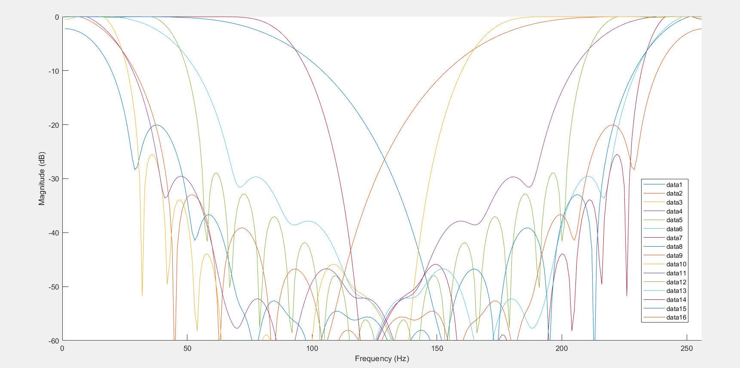
Result of Design Model

Slide 12
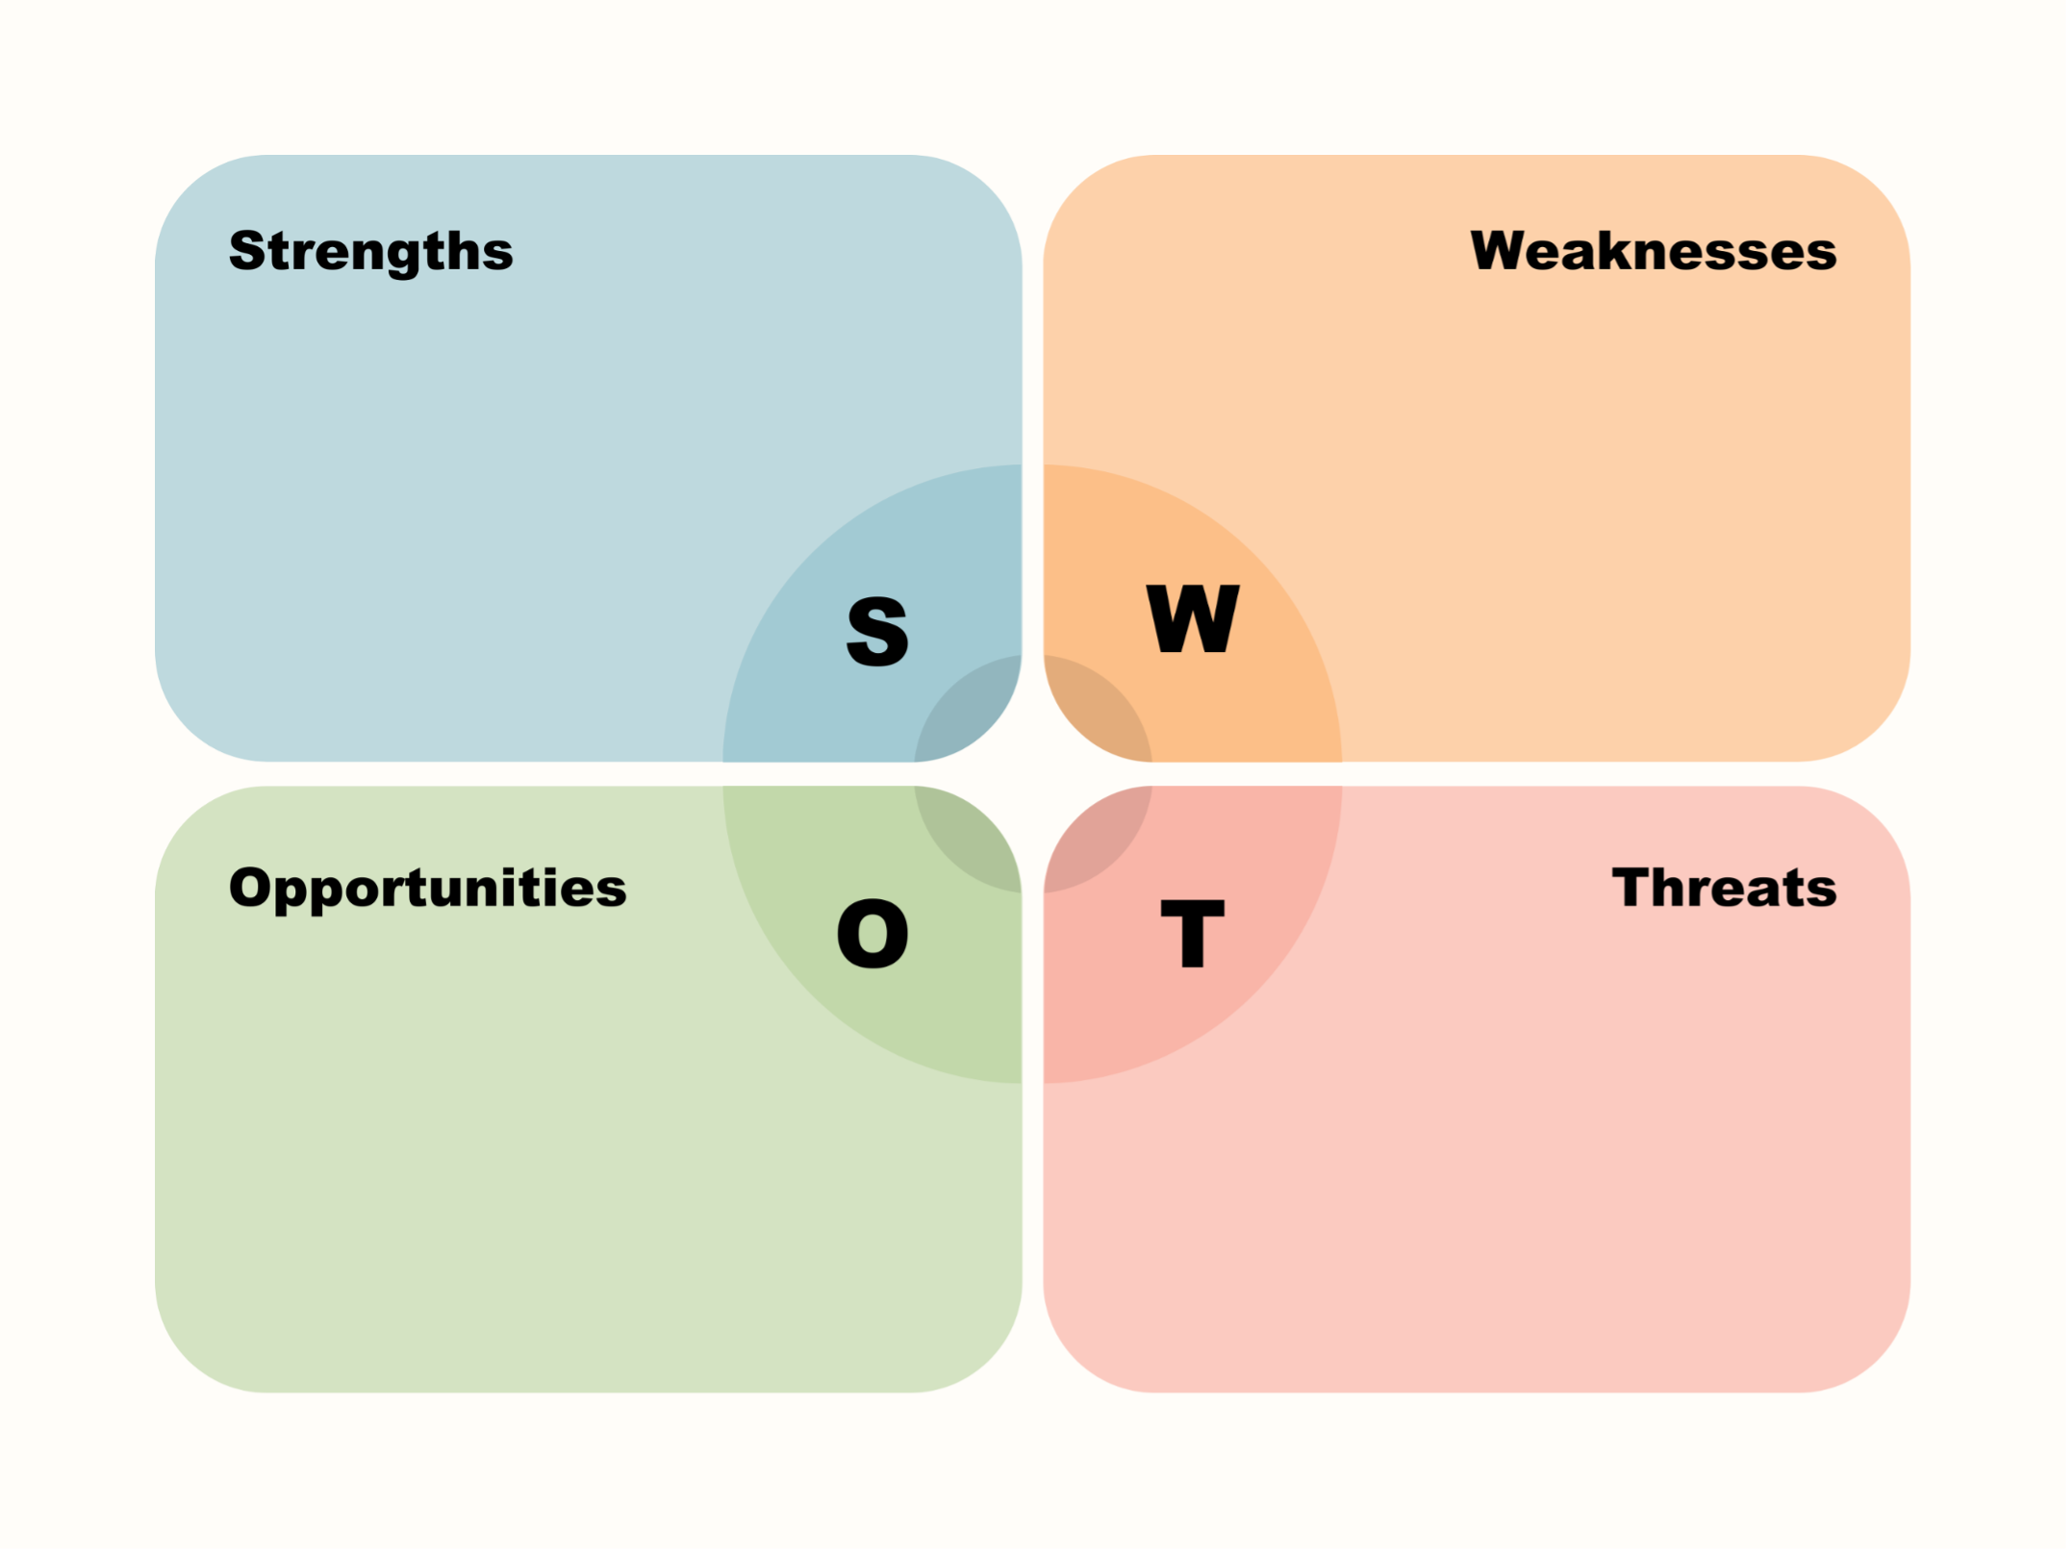
SWOT ANALYSIS
Adaptive Frequency Resolution: The non-uniform filter bank allows adaptive tuning to an individual's hearing profile.
Selective Amplification: The filter bank's ability to selectively amplify relevant speech frequencies can improve the user experience by focusing on areas of hearing loss.
Complex Design and Optimization : potentially increasing development complexity.
Trade-off with Precision : impacting the accuracy of signal processing.
Technological Advancements: the FRM-based non-uniform filter bank for hearing aids.
Market Growth: With an aging population and increasing awareness of hearing health
Competitive Landscape: The success of innovative technologies depends on market acceptance and differentiation from existing solutions.
Regulatory Compliance: Meeting stringent regulatory requirements for medical devices.

Slide 13
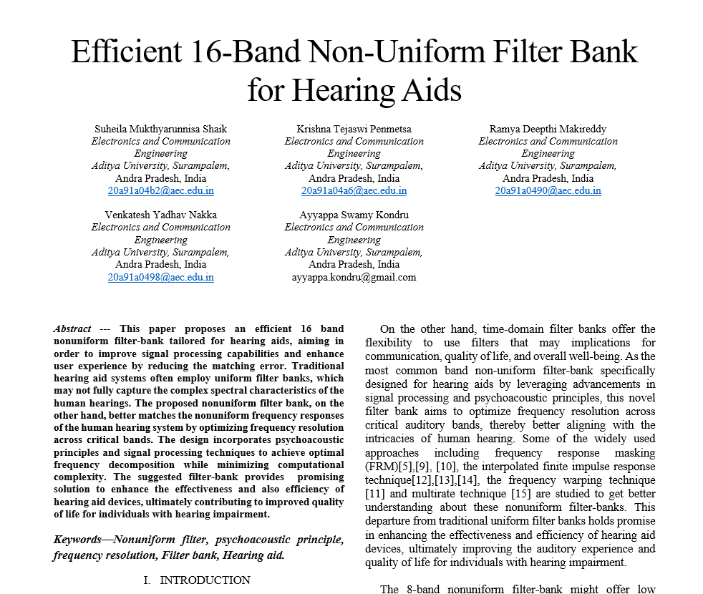
Screen Shot of Drafted/Communicated/Accepted status of Journal/Conference Paper with Guide Sign

Slide 14
REFERENCES
Y. Kuo, T. Lin, Y. Li, and C. W. Liu, “Design and implementation of low-power ANSI S1.11 filter bank for digital hearing aids,” IEEE Trans. Circuits Syst. I, Regular Papers, vol. 57, no. 7, pp. 1684–1696, Jul. 2010
S.-C. Lai, C.-H. Liu, L.-Y. Wang, S.-H. Chen, and K.-H. Chen, “11.25-msgroup-delay and low-complexity algorithm design of 18-band quasi-ANSI S1.11 1/3 octave digital a for hearing aids,” IEEE Trans. Circuits Syst. I, Regular Papers, vol. 62, no. 6, pp. 1572–1581, Jun. 2015
Y. Wei and D. Liu, “A reconfigurable digital filterbank for hearing-aid systems with a variety of sound wave decomposition plans,” IEEE Trans. Biomed. Eng., vol. 60, no. 6, pp. 1628–1635, Jun. 2013.
A. Amir, T. S. Bindiya, and E. Elias, “Design and implementation of reconfigurable filter bank structure for low complexity hearing aids using 2-level sound wave decomposition,” Biomed. Signal Process. Control, vol. 43, pp. 96–109, 2018
Aditya Engineering College (A)

Slide 15

Aditya Engineering College (A)

Slide 16
THANK YOU
Aditya Engineering College (A)

